Slide 1
Indicator of Generalization
Notes:
Information theory
Information theory 打臉
Geometric optimization and implicit regularization
Theory of learning II
Theory of learning III
Exploring generalization in deep learning
Sharp Minima Can Generalize For Deep Nets
ML theory (good explanation):
https://mostafa-samir.github.io/ml-theory-pt1/
https://mostafa-samir.github.io/ml-theory-pt2/

Slide 2
Introduction
Function Set of
Deep Network
Training zero is zero
If many global optimums can zero training errors, which one can obtain generalized results?
Use the indicator to find solution that generalizes well.
Sharpness and Sensitivity

Slide 3
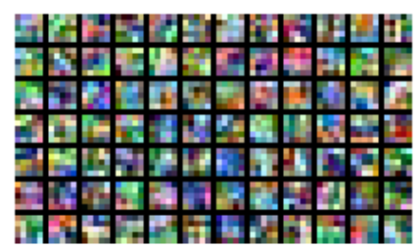
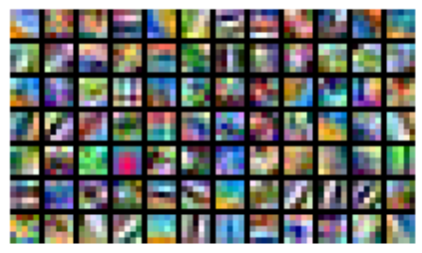
Brute-force Memorization ?
Real labels v.s. random labels
First layer of CIFAR-10
https://arxiv.org/pdf/1706.05394.pdf
Notes:
David Krueger*, Nicolas Ballas*, Stanislaw Jastrzebski*, Devansh Arpit*, Maxinder S. Kanwal, Tegan Maharaj, Emmanuel Bengio, Asja Fischer, Aaron Courville, Deep Net Don't Learn Via Memorization, ICLR 2017, workshop

Slide 4
Brute-force Memorization ?
https://arxiv.org/pdf/1706.05394.pdf
Simple pattern first, then memorize exception

Slide 5
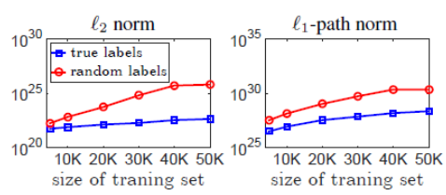
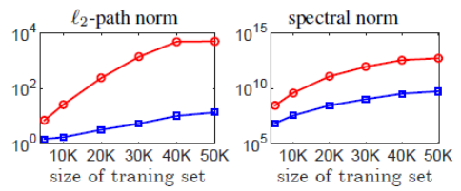
Brute-force Memorization ?

Slide 6
Sensitivity
Notes:
Roman Novak, Yasaman Bahri, Daniel A. Abolafia, Jeffrey Pennington, Jascha Sohl-Dickstein, Sensitivity and Generalization in Neural Networks: an Empirical Study, ICLR, 2018
Testing data is available.

Slide 7
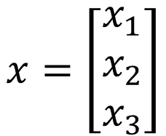
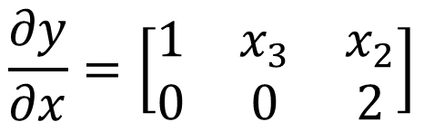

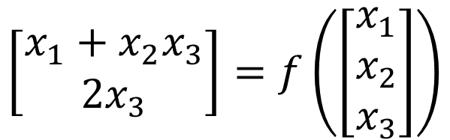
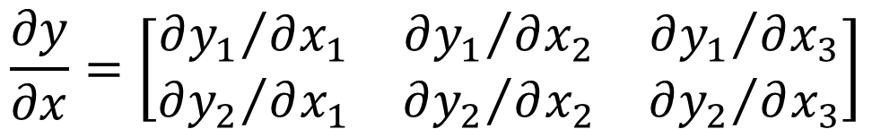
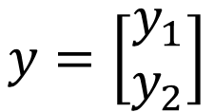
Jacobian Matrix
$$x=\left[\begin{aligned}x_{1} \\ x_{2} \\ x_{3}\end{aligned}\right]$$
$$y=\left[\begin{aligned}y_{1} \\ y_{2}\end{aligned}\right]$$
$$y=f\left(x\right)$$
$$\frac{∂y}{∂x}=\left[\begin{matrix}{∂y_{1}}/{∂x_{1}} & {∂y_{1}}/{∂x_{2}} & {∂y_{1}}/{∂x_{3}} \\ {∂y_{2}}/{∂x_{1}} & {∂y_{2}}/{∂x_{2}} & {∂y_{2}}/{∂x_{3}}\end{matrix}\right]$$
size of y
Example
size of x
$$\left[\begin{aligned}x_{1}+x_{2}x_{3} \\ 2x_{3}\end{aligned}\right]=f\left(\left[\begin{aligned}x_{1} \\ x_{2} \\ x_{3}\end{aligned}\right]\right)$$
$$\frac{∂y}{∂x}=\left[\begin{matrix}1 & x_{3} & x_{2} \\ 0 & 0 & 2\end{matrix}\right]$$

Slide 8



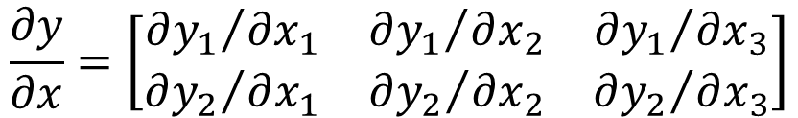
Sensitivity
Given a network $f$, the sensitivity of a data point x is the Frobenius norm of the Jacobian
$$\frac{∂y}{∂x}=\left[\begin{matrix}{∂y_{1}}/{∂x_{1}} & {∂y_{1}}/{∂x_{2}} & {∂y_{1}}/{∂x_{3}} \\ {∂y_{2}}/{∂x_{1}} & {∂y_{2}}/{∂x_{2}} & {∂y_{2}}/{∂x_{3}}\end{matrix}\right]$$
$$y=f\left(x\right)$$
$$=\sqrt{\sum_{i}{\sum_{j}{{\left(\frac{∂y_{j}}{∂x_{i}}\right)}^{2}}}}$$
By the sensitivity of a test data x, we can predict the performance.
Sensitivity of x
Without label
It is not surprise that sensitivity is related to generalization.
Regularization is kind of minimziing sensitivity.

Slide 9
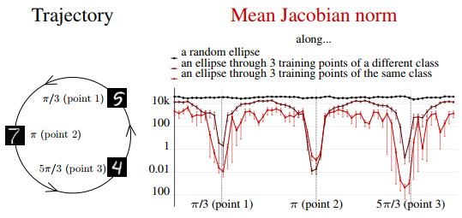
Sensitivity – Emprical Results
Sensitivity on and off the training data manifold

Slide 10
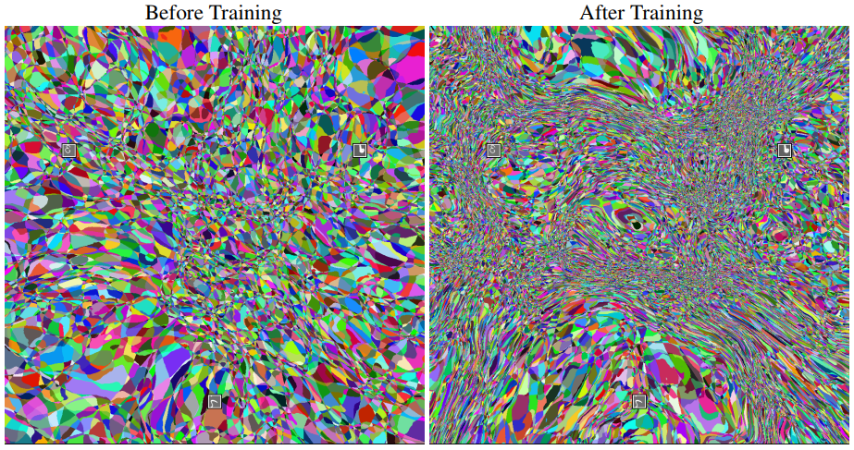
Sensitivity – Emprical Results
Sensitivity on and off the training data manifold

Slide 13
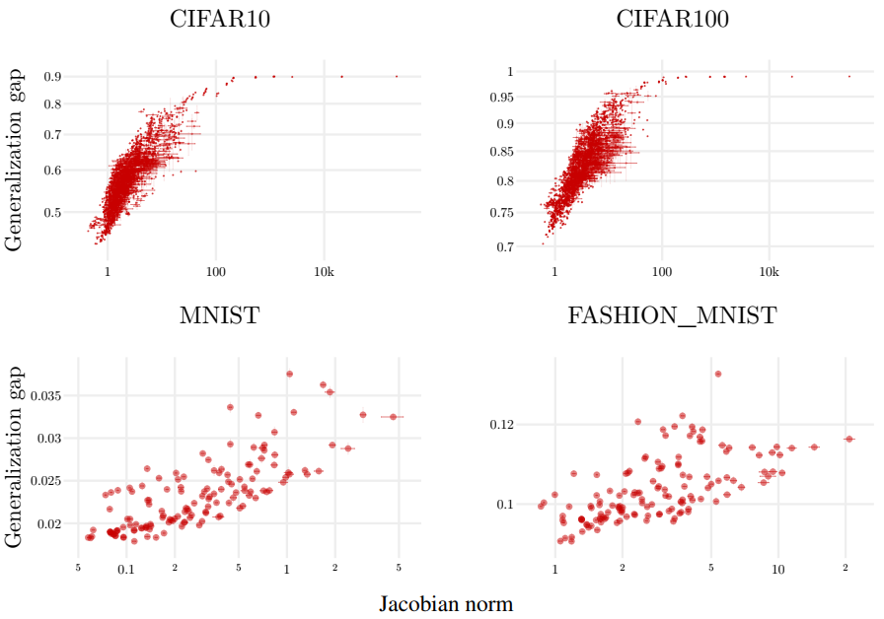
Sensitivity v.s. Generalization

Slide 14
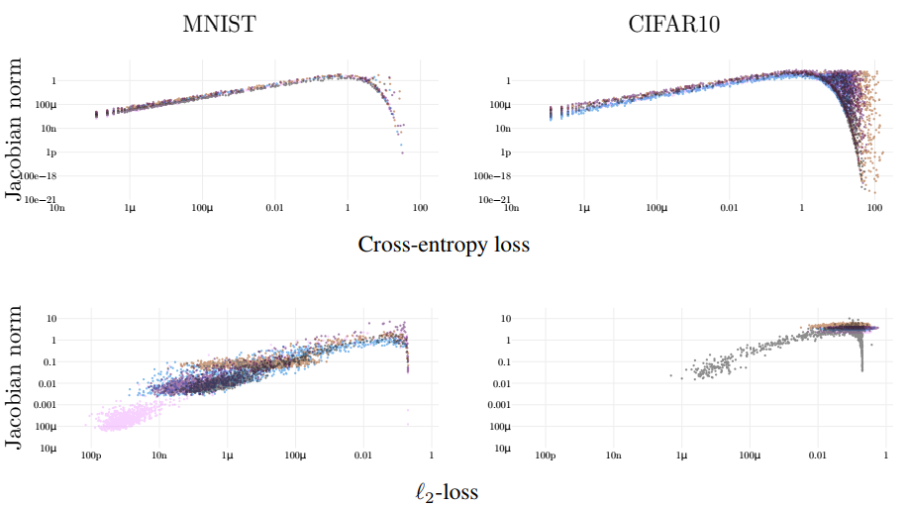
Sensitivity v.s. Generalization
individual points

Slide 15
Sharpness
Notes:
In a recent paper from Google it was shown that the optimum batch size is proportional to the learning rate and the training set size. Or simply put in other words, “Don’t Decay the Learning Rate, Increase the Batch Size”. Similarly scaling rules were derived for SGD with momentum: Bopt ~1/(1 − m), where Bopt is an optimal batch size and m is momentum. Alternatively, all conclusions can be summarised by the following equation:
Such a definition, if it also lends itself to easy computation, can also act as a regularizer for DNN training. Two examples:
Elastic-SGD: Maximize
Path-SGD: With RelU activation, scaling of weights in one layer can be compensated for exactly in a subsequent layer. Path-SGD works with “steepest descent” direction under such scaling invariance.

Slide 16
Sharp Minima v.s Flat Minima
bad generalization
Testing Loss
good generalization
Training Loss
Flat Minima
Sharp Minima
Explain self regularization?
Notes:
For DNNs, Flatness plays a role similar to Margin for kernel methods

Slide 17
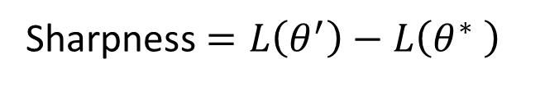






Definition of Sharpness
Definition 1
Definition 2
Sharpness $=L\left(θ^{′}\right)−L\left(θ^{∗} \right)$
sharpness
$$θ^{′}$$
$$ε$$
$$θ^{∗}$$
$$θ^{∗}$$
$$θ^{∗}−ε$$
$$θ^{∗}+ε$$

Slide 18
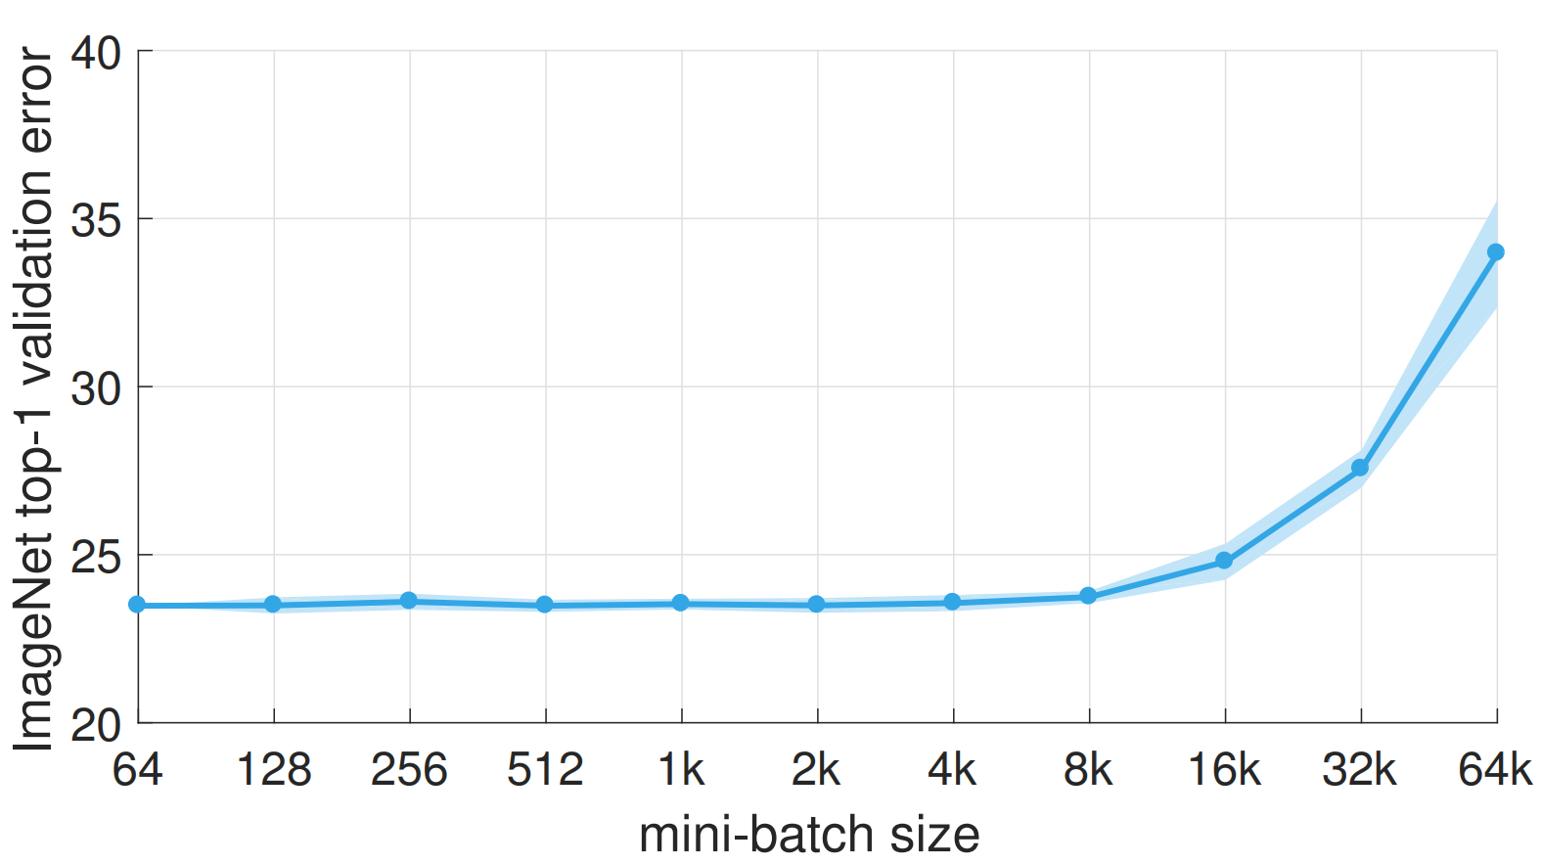
Batch Size
https://arxiv.org/pdf/1706.02677.pdf
Notes:
TIMIT, CIFAR-10

Slide 19
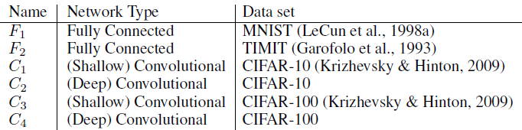
Batch Size v.s. Sharpness
SB = 256
LB =
0.1 x data set

Slide 20
Batch Size v.s. Sharpness
Small Batch
Large Batch

Slide 21
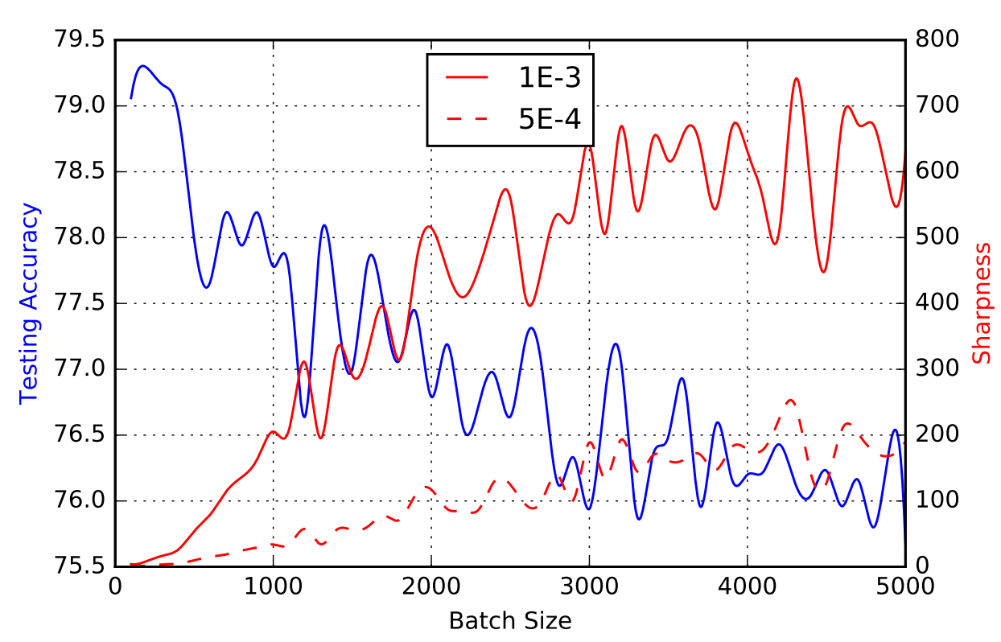
Batch Size v.s. Sharpness

Slide 22
Concluding Remarks
Notes:
Information theory
Information theory 打臉
Geometric optimization and implicit regularization
Theory of learning II
Theory of learning III
Exploring generalization in deep learning
Sharp Minima Can Generalize For Deep Nets
ML theory (good explanation):
https://mostafa-samir.github.io/ml-theory-pt1/
https://mostafa-samir.github.io/ml-theory-pt2/

Slide 23
Summary
Good generalization are associated with sensitivity
Good generalization are associated with flatness (?)
Understanding the indicator for generalization helps us develop algorithm in the future
感謝 張景程 同學發現投影片上的錯字

Slide 24
Reference
Devansh Arpit, Stanisław Jastrzębski, Nicolas Ballas, David Krueger, Emmanuel Bengio, Maxinder S. Kanwal, Tegan Maharaj, Asja Fischer, Aaron Courville, Yoshua Bengio, Simon Lacoste-Julien, “A Closer Look at Memorization in Deep Networks”, ICML, 2017
Nitish Shirish Keskar, Dheevatsa Mudigere, Jorge Nocedal, Mikhail Smelyanskiy, Ping Tak Peter Tang, “On Large-Batch Training for Deep Learning: Generalization Gap and Sharp Minima”, ICLR, 2017
Pratik Chaudhari, Anna Choromanska, Stefano Soatto, Yann LeCun, Carlo Baldassi, Christian Borgs, Jennifer Chayes, Levent Sagun, Riccardo Zecchina, “Entropy-SGD: Biasing Gradient Descent Into Wide Valleys”, ICLR, 2017
Behnam Neyshabur, Srinadh Bhojanapalli, David McAllester, Nathan Srebro, Exploring Generalization in Deep Learning, NIPS, 2017
Laurent Dinh, Razvan Pascanu, Samy Bengio, Yoshua Bengio, Sharp Minima Can Generalize For Deep Nets, PMLR, 2017
Roman Novak, Yasaman Bahri, Daniel A. Abolafia, Jeffrey Pennington, Jascha Sohl-Dickstein, Sensitivity and Generalization in Neural Networks: an Empirical Study, ICLR, 2018

